Slide 1
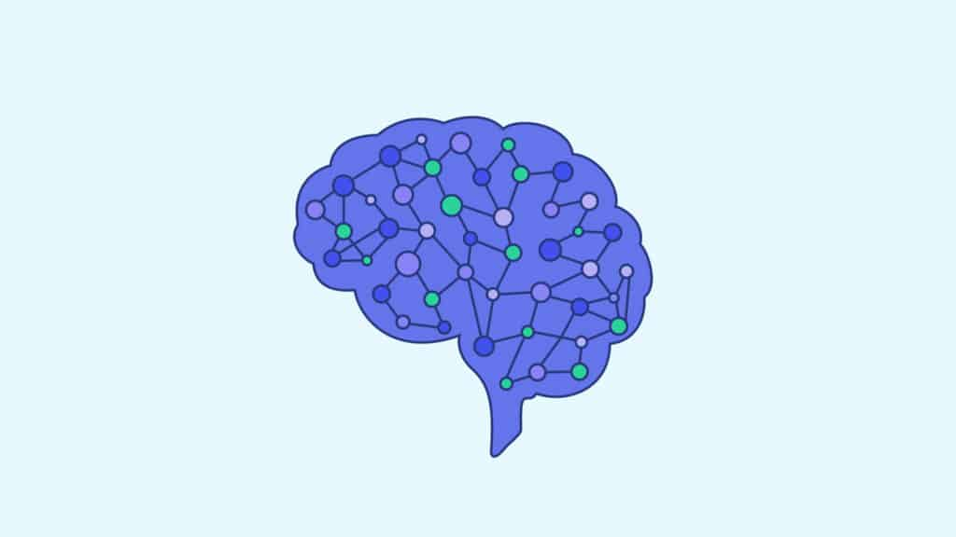
Neural Network
A Neural Network is a machine learning model inspired by the human brain, designed to recognize patterns and make predictions.
Neural networks consist of layers of interconnected nodes (neurons), which process data and pass it forward through the network. They are especially effective for complex tasks like image recognition, natural language processing, and speech recognition.
https://images.app.goo.gl/ypKmGHW8zicESPKy6

Slide 2
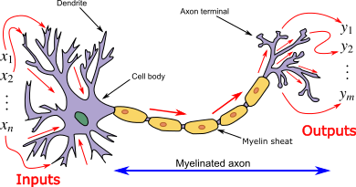
Neural Network: Biological Neuron
Dendrites: Input
Cell body: Processor
Synaptic: Link
Axon: Output
https://nischal.info.np/very-stupid-introduction-to-deep-learning

Slide 3
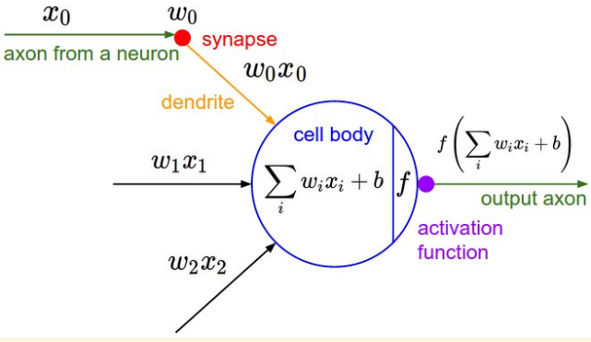
Neural Network: Artificial Neuron

Slide 4
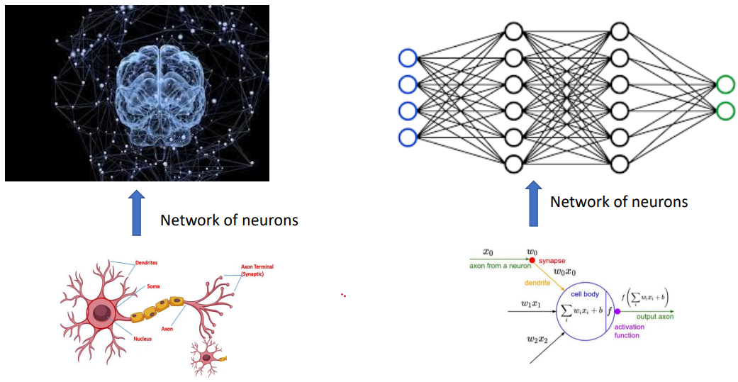
Neural Network

Slide 5
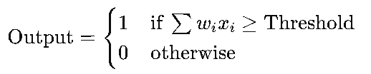
Neural Network: MCP Neuron
The McCulloch-Pitts (MCP) Neuron is one of the earliest models of a neuron, introduced by Warren McCulloch and Walter Pitts in 1943.
This simple, binary model was foundational in the development of artificial neural networks and provided a mathematical basis for how a neuron could operate within a network.
An MCP Neuron takes multiple binary (on/off) inputs and provides a single binary output. The neuron activates (outputs 1) when a specific number of inputs are on or active. This occurs when the sum of these inputs surpasses a set threshold.
The inputs in the MCP Neuron model are binary, represented as 1 (on) or 0 (off), and each input is weighted with identical values.

Slide 6
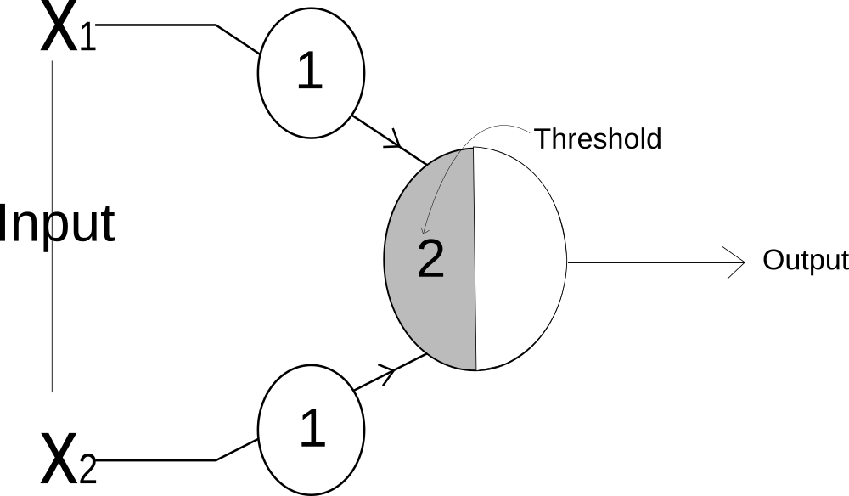
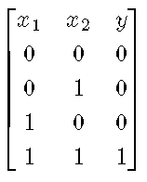
Neural Network: MCP Neuron
AND Gate
AND Gate is the logic gate that implements conjuction. Whenever both inputs are active then only the output will be activated.

Slide 7

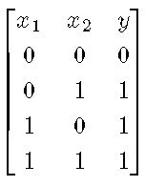
Neural Network: MCP Neuron
OR GATE
In OR Gate, output is activated if any one of the input is active.

Slide 8
Neural Network: Perceptron
Building on the ideas of the MCP Neuron, Frank Rosenblatt introduced the Perceptron in 1957, enhancing the model to allow more complex learning. While it shares similarities with the MCP Neuron, Rosenblatt’s Perceptron introduced several improvements:
Numerical Inputs: Instead of binary (0 or 1) inputs, the Perceptron can handle a broader range of input values, which allows for more nuanced representations and a wider variety of tasks.
Variable Weights: Each input in the Perceptron has an adjustable weight, rather than the fixed, identical weights used in the MCP model. These weights determine the contribution of each input to the final output, and they are learned during training.
Bias: Rosenblatt also introduced the bias term, which helps shift the activation threshold, enabling the Perceptron to classify data points even if they don’t pass through the origin. The bias acts as an extra input with a constant value (usually 1), allowing the Perceptron to adjust the activation boundary for better classification.

Slide 9
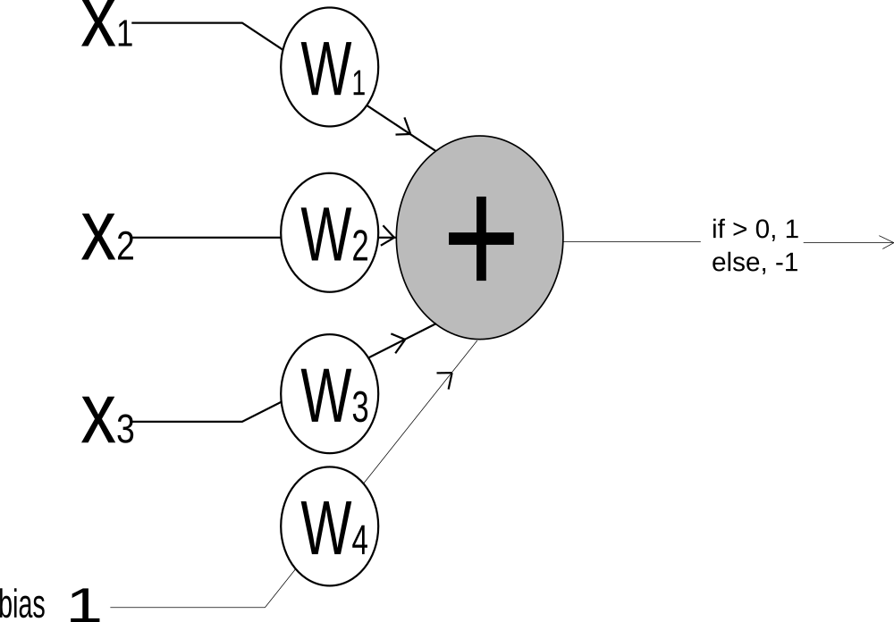
Neural Network: Perceptron
The Perceptron functions similarly to the MCP Neuron. It takes multiple inputs, scales each by a weight, and sums all the weighted inputs. This sum is then compared to a threshold value: if the sum exceeds the threshold, the Perceptron outputs 1; otherwise, it outputs -1 (or in some variations, outputs are set to 1 and 0, respectively). This threshold-based activation helps the Perceptron decide which class a given input belongs to, making it a simple but foundational classifier.

Slide 10
Neural Network: Perceptron
Limitations of Perceptron
The perceptron primarily uses a step function as its activation function, which produces binary outputs (1 or 0). It is limited to linear problems, as it lacks the complexity to model non-linear patterns.
The perceptron can only solve linearly separable problems (where data points can be divided by a straight line). It struggles with complex patterns, such as the XOR problem, which are not linearly separable.
This limitation led to the development of multi-layer perceptrons (MLPs), which can handle non-linear decision boundaries through the use of hidden layers and non-linear activation functions.
Let see an example first!

Slide 11
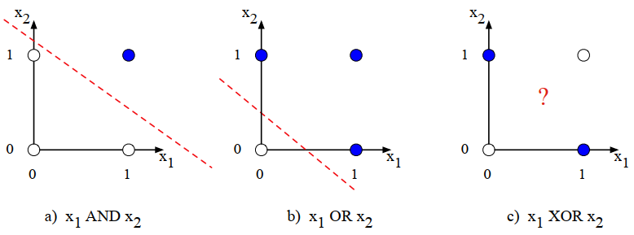
Neural Network: Perceptron
Limitations of Perceptron: XOR problem
The functions AND, OR, and XOR, represented with input x1 on the x-axis and input x2 on the y-axis.
Filled circles represent perceptron outputs of 1, and white circles perceptron outputs of 0. There is no way to draw a line that correctly separates the two categories for XOR.

Slide 12
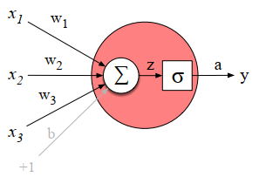




Neural Network: Artificial Neuron
An artificial neuron in modern networks can apply various non-linear activation functions, such as sigmoid, ReLU, or tanh, allowing it to capture complex, non-linear relationships in data. It is a fundamental unit in deep learning models, contributing to hidden and output layers.
A neural unit, taking 3 inputs x1, x2, and x3 (and a bias b that we represent as a weight for an input clamped at +1) and producing an output y.
We include some convenient intermediate variables: the output of the summation, z, and the output of the sigmoid, a. In this case the output of the unit y is the same as a.

Slide 13





Neural Network: Artificial Neuron
Let’s walk through an example just to get an intuition. Let’s suppose we have a
unit with the following weight vector and bias: w = [0.2, 0.3, 0:9] and b = 0.5
What would this unit do with the following input vector: x = [0.5, 0.6, 0.1]
In practice, the sigmoid is not commonly used as an activation function. A function that is very similar but almost always better is the tanh function.
The simplest activation function, and perhaps the most commonly used, is the rectified linear unit, also called the ReLU.

Slide 14
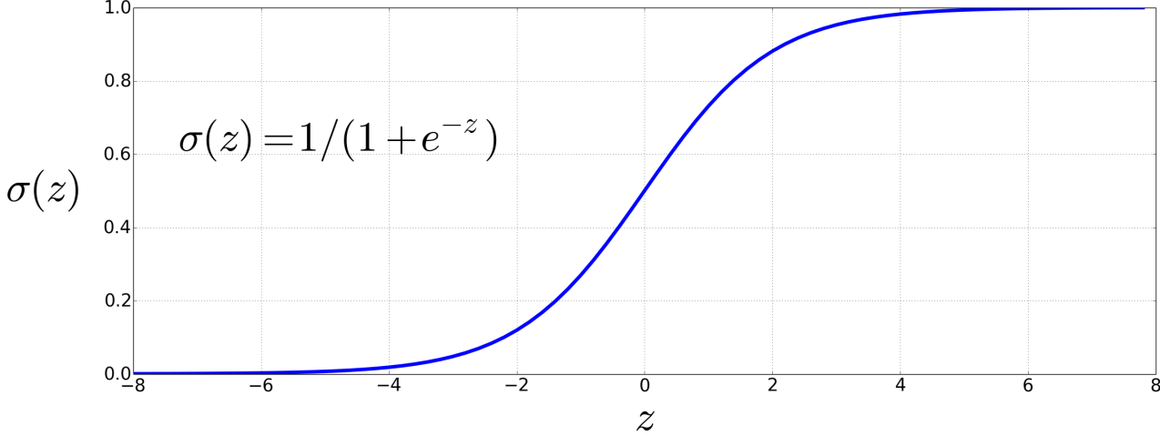
Neural Network: Activation Function
The sigmoid has a number of advantages; it maps the output into the range (0;1), which is useful in squashing outliers toward 0 or 1.
The sigmoid function takes a real value and maps it to the range (0,1). It is nearly linear around 0 but outlier values get squashed toward 0 or 1.

Slide 15
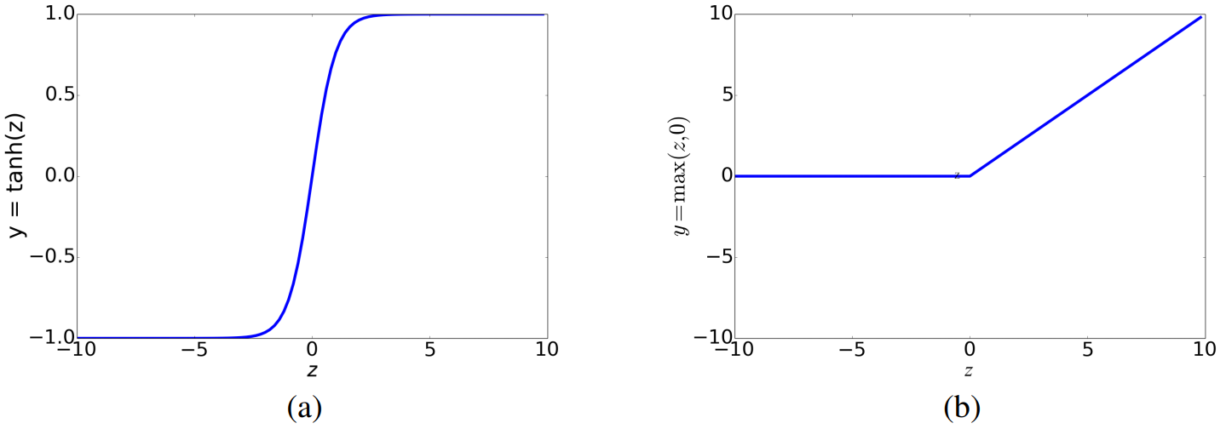
Neural Network: Activation Function
These activation functions have different properties that make them useful for network architectures. For example, the tanh function has the nice properties of being smoothly differentiable and mapping outlier values toward the mean.
The rectifier function, on the other hand, has nice properties that result from it being very close to linear.
The tanh and ReLU activation functions.

Slide 16
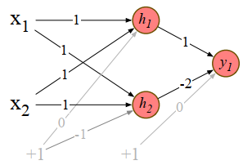
Artificial Neural Network
Limitations of Perceptron: XOR problem
While the XOR function cannot be calculated by a single perceptron, it can be calculated by a layered network of perceptron units. Rather than see this with networks of simple perceptrons, however, let’s see how to compute XOR using two layers of ReLU-based units.
Fig. shows a figure with the input being processed by two layers of neural units. The middle layer (called h) has two units, and the output layer (called y) has one unit.
A set of weights and biases are shown that allows the network to correctly compute the XOR function.
There are three ReLU units, in two layers; we’ve called them h1, h2 (h for “hidden layer”) and y1. As before, the numbers on the arrows represent the weights w for each unit, and we represent the bias b as a weight on a unit clamped to +1, with the bias weights/units in gray.

Slide 17
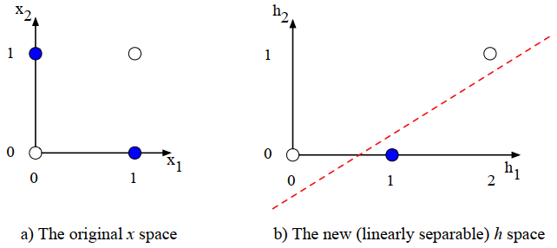
Artificial Neural Network
Limitations of Perceptron: XOR problem
The hidden layer forming a new representation of the input. (b) shows the representation of the hidden layer, h, compared to the original input representation x in (a).
Notice that the input point [0, 1] has been collapsed with the input point [1, 0], making it possible to linearly separate the positive and negative cases of XOR.

Slide 18
Artificial Neural Network
Multi Layer Perceptrons and Feed Forward Networks
Historically, multilayer networks, particularly feed forward networks, are often referred to as multi-layer perceptrons (MLPs). However, this is technically a misleading term.
Traditional perceptrons are linear units, while modern networks consist of units with non-linear activation functions, like sigmoids or ReLUs. Nonetheless, the term "MLP" has become widely adopted over time.
In simple feed forward networks, there are three types of nodes:
Input units: which receive the data;
Hidden units: which process data through non-linear transformations; and
Output units: which produce the final output of the network.

Slide 19
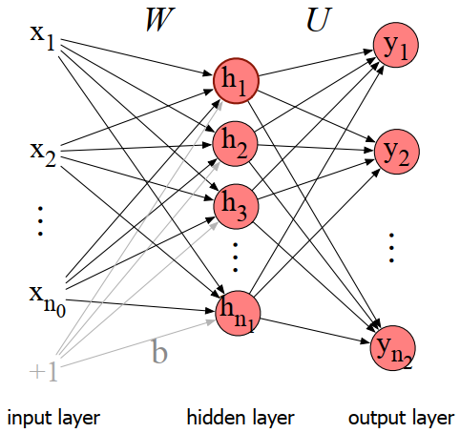
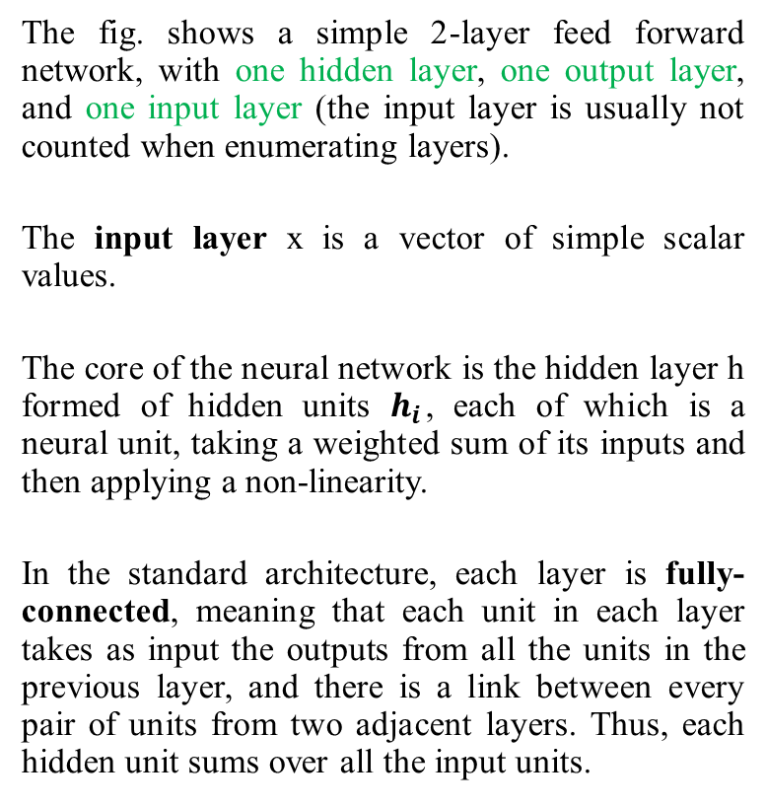
Artificial Neural Network
Feed Forward Networks
The fig. shows a simple 2-layer feed forward network, with one hidden layer, one output layer, and one input layer (the input layer is usually not counted when enumerating layers).
The input layer x is a vector of simple scalar values.
The core of the neural network is the hidden layer h formed of hidden units $h_{i}$, each of which is a neural unit, taking a weighted sum of its inputs and then applying a non-linearity.
In the standard architecture, each layer is fully-connected, meaning that each unit in each layer takes as input the outputs from all the units in the previous layer, and there is a link between every pair of units from two adjacent layers. Thus, each hidden unit sums over all the input units.

Slide 20
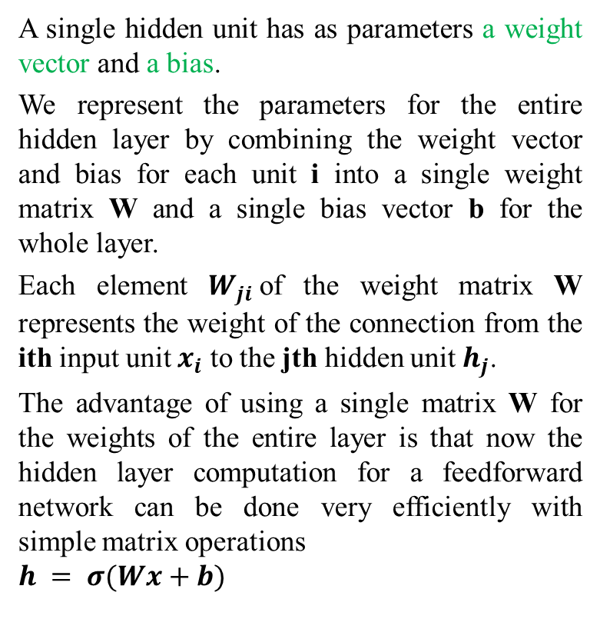
Artificial Neural Network
Feed Forward Networks
A single hidden unit has as parameters a weight vector and a bias.
We represent the parameters for the entire hidden layer by combining the weight vector and bias for each unit i into a single weight matrix W and a single bias vector b for the whole layer.
Each element $W_{ji}$of the weight matrix W represents the weight of the connection from the ith input unit $x_{i}$ to the jth hidden unit${ h}_{j}$.
The advantage of using a single matrix W for the weights of the entire layer is that now the hidden layer computation for a feedforward network can be done very efficiently with simple matrix operations
$$h = σ(Wx+b)$$

Slide 21
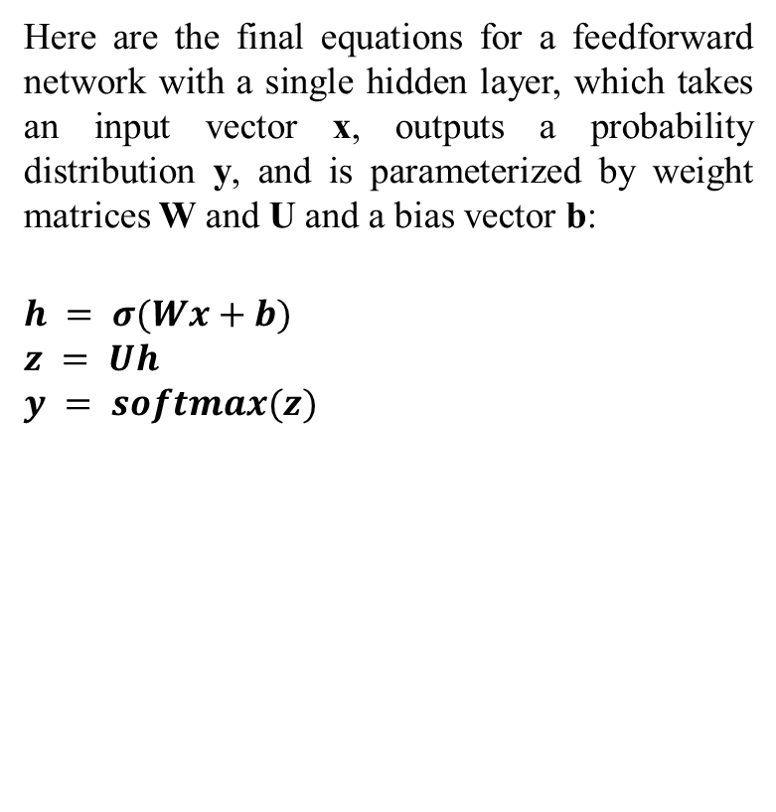
Artificial Neural Network
Feed Forward Networks
Here are the final equations for a feedforward network with a single hidden layer, which takes an input vector x, outputs a probability distribution y, and is parameterized by weight matrices W and U and a bias vector b:
$$h = σ(Wx+b)$$
$$z = Uh$$
$$y = softmax(z)$$

Slide 22
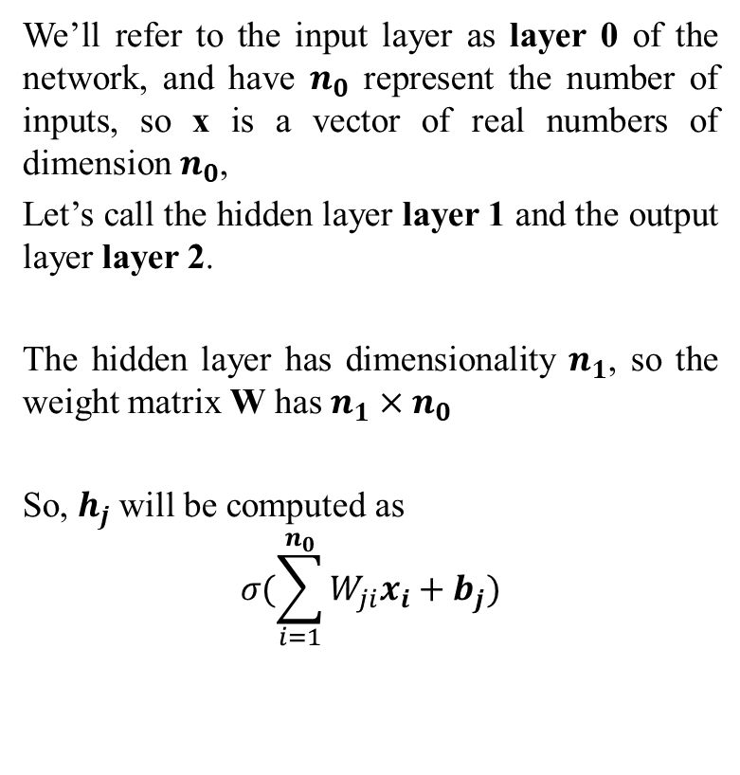
Artificial Neural Network
Feed Forward Networks
We’ll refer to the input layer as layer 0 of the network, and have $n_{0}$ represent the number of inputs, so x is a vector of real numbers of dimension $n_{0}$,
Let’s call the hidden layer layer 1 and the output layer layer 2.
The hidden layer has dimensionality $n_{1}$, so the weight matrix W has $n_{1}×n_{0}$
So, $h_{j}$will be computed as
$$σ(\sum_{i=1}^{n_{0}}{W_{ji}x_{i}+b_{j}})$$

Slide 23
Artificial Neural Network
Feed Forward Networks
If we are doing a binary task like spam classification, we might have a single output node, and its scalar value y is the probability of positive versus negative class.
If we are doing multinomial classification, we might have one output node for each potential class, and the values of all the output nodes must sum to one.
The output layer is thus a vector y that gives a probability distribution across the output nodes.

Slide 24

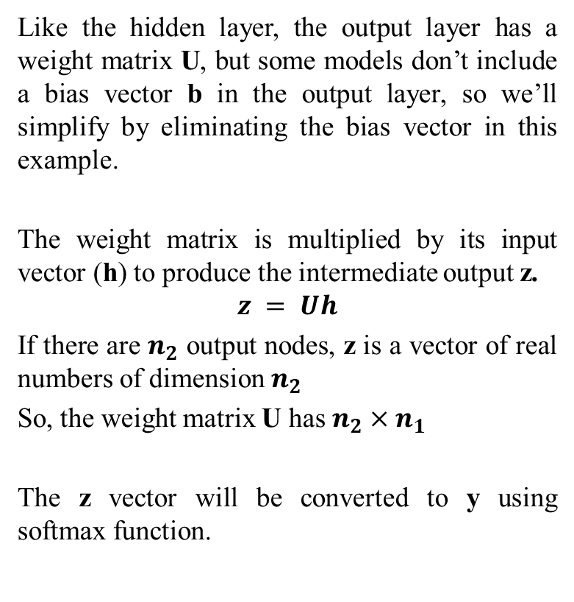
Artificial Neural Network
Feed Forward Networks
Like the hidden layer, the output layer has a weight matrix U, but some models don’t include a bias vector b in the output layer, so we’ll simplify by eliminating the bias vector in this example.
The weight matrix is multiplied by its input vector (h) to produce the intermediate output z.
$$z = Uh$$
If there are $n_{2}$ output nodes, z is a vector of real numbers of dimension $n_{2}$
So, the weight matrix U has $n_{2}×n_{1}$
The z vector will be converted to y using softmax function.

Slide 25
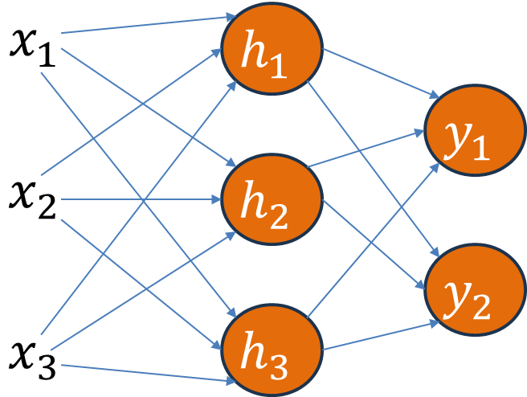
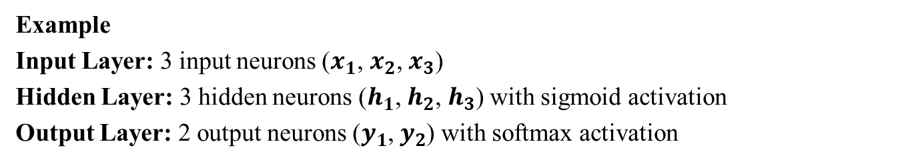
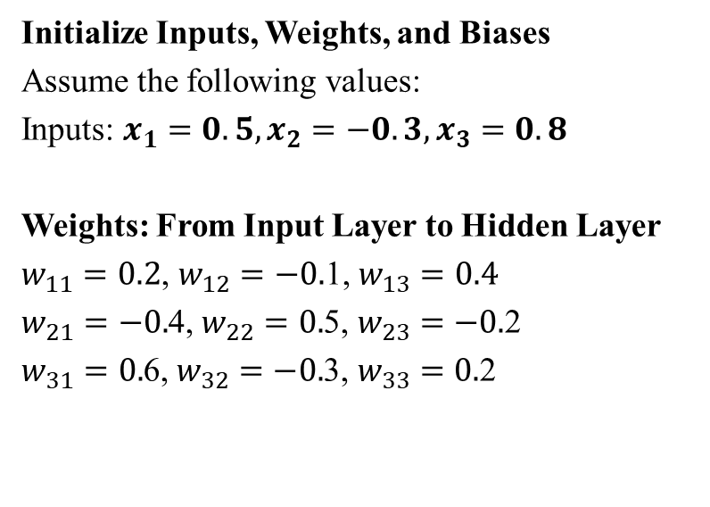
Artificial Neural Network
Example
Input Layer: 3 input neurons ($x_{1}$, $x_{2}$, $x_{3}$)
Hidden Layer: 3 hidden neurons ($h_{1}$, $h_{2}$, $h_{3}$) with sigmoid activation
Output Layer: 2 output neurons ($y_{1}$, $y_{2}$) with softmax activation
Initialize Inputs, Weights, and Biases
Assume the following values:
Inputs: $x_{1}=0.5, x_{2}=−0.3, x_{3}=0.8$
Weights: From Input Layer to Hidden Layer
$w_{11}=0.2$, $w_{12}=−0.$1, $w_{13}=0.4$
$w_{21}=−0.$4, $w_{22}=0.$5, $w_{23}=−0.$2
$w_{31}=0.$6, $w_{32}=−0.$3, $w_{33}=0.$2

Slide 26
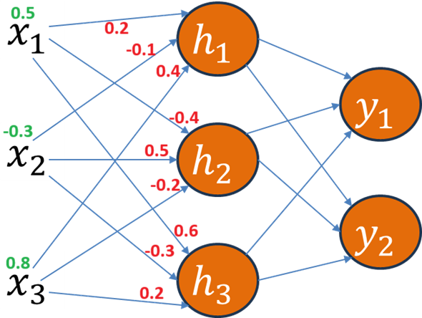
Artificial Neural Network
Example
Input Layer: 3 input neurons ($x_{1}$, $x_{2}$, $x_{3}$)
Hidden Layer: 3 hidden neurons ($h_{1}$, $h_{2}$, $h_{3}$) with sigmoid activation
Output Layer: 2 output neurons ($y_{1}$, $y_{2}$) with softmax activation
Initialize Inputs, Weights, and Biases
Assume the following values:
Inputs: $x_{1}=0.5, x_{2}=−0.3, x_{3}=0.8$
Weights: From Input Layer to Hidden Layer
$w_{11}=0.2$, $w_{12}=−0.$1, $w_{13}=0.4$
$w_{21}=−0.$4, $w_{22}=0.$5, $w_{23}=−0.$2
$w_{31}=0.$6, $w_{32}=−0.$3, $w_{33}=0.$2

Slide 27
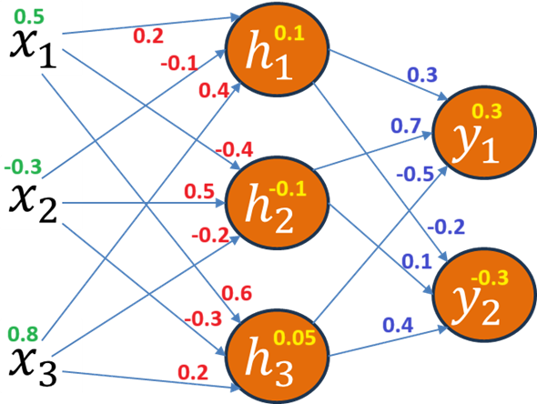
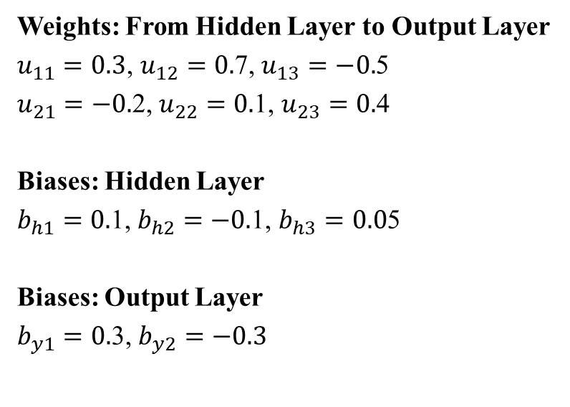
Artificial Neural Network
Example
Input Layer: 3 input neurons ($x_{1}$, $x_{2}$, $x_{3}$)
Hidden Layer: 3 hidden neurons ($h_{1}$, $h_{2}$, $h_{3}$) with sigmoid activation
Output Layer: 2 output neurons ($y_{1}$, $y_{2}$) with softmax activation
Weights: From Hidden Layer to Output Layer
$u_{11}=0.3$, $u_{12}=0.$7, $u_{13}=−0.$5
$u_{21}=−0.$2, $u_{22}=0.$1, $u_{23}=0.$4
Biases: Hidden Layer
$b_{h1}=0.$1, $b_{h2}=−0.$1, $b_{h3}=0.0$5
Biases: Output Layer
$b_{y1}=0.$3, $b_{y2}=−0.3$

Slide 28


Artificial Neural Network
Example
Input Layer: 3 input neurons ($x_{1}$, $x_{2}$, $x_{3}$)
Hidden Layer: 3 hidden neurons ($h_{1}$, $h_{2}$, $h_{3}$) with sigmoid activation
Output Layer: 2 output neurons ($y_{1}$, $y_{2}$) with softmax activation
Activation Functions
Sigmoid activation for the hidden layer:
Softmax activation for the output layer:

Slide 29
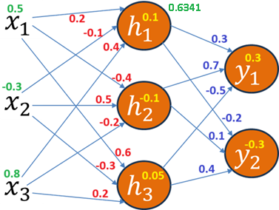
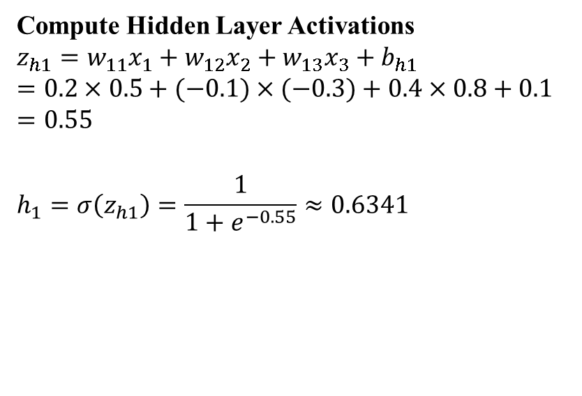
Artificial Neural Network
Example
Input Layer: 3 input neurons ($x_{1}$, $x_{2}$, $x_{3}$)
Hidden Layer: 3 hidden neurons ($h_{1}$, $h_{2}$, $h_{3}$) with sigmoid activation
Output Layer: 2 output neurons ($y_{1}$, $y_{2}$) with softmax activation
Compute Hidden Layer Activations
$$z_{h1}=w_{11}x_{1}+w_{12}x_{2}+w_{13}x_{3}+b_{h1}$$
$$=0.2×0.5+(−0.1)×(−0.3)+0.4×0.8+0.1$$
$$=0.55$$
$$h_{1}=σ\left(z_{h1}\right)=\frac{1}{1+e^{−0.55}}≈0.6341$$

Slide 30
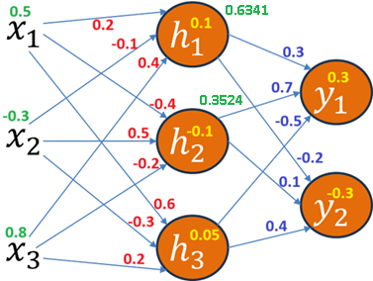
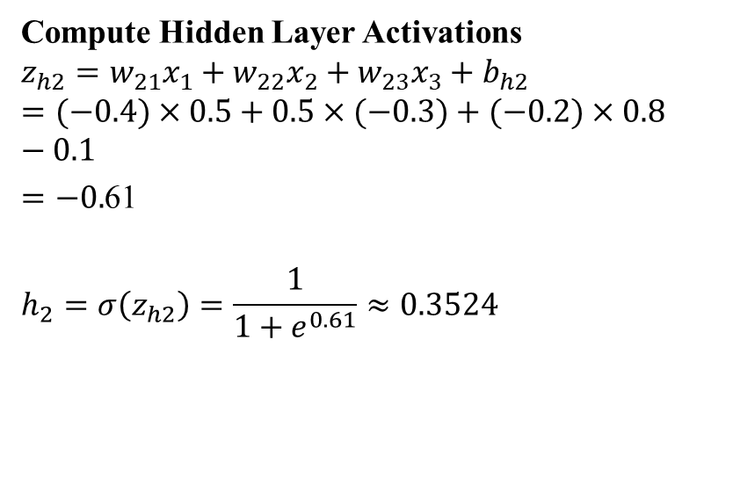
Artificial Neural Network
Example
Input Layer: 3 input neurons ($x_{1}$, $x_{2}$, $x_{3}$)
Hidden Layer: 3 hidden neurons ($h_{1}$, $h_{2}$, $h_{3}$) with sigmoid activation
Output Layer: 2 output neurons ($y_{1}$, $y_{2}$) with softmax activation
Compute Hidden Layer Activations
$$z_{h2}=w_{21}x_{1}+w_{22}x_{2}+w_{23}x_{3}+b_{h2}$$
$$=(−0.4)×0.5+0.5×(−0.3)+(−0.2)×0.8−0.1$$
$=−0.$61
$$h_{2}=σ\left(z_{h2}\right)=\frac{1}{1+e^{0.61}}≈0.3524$$

Slide 31
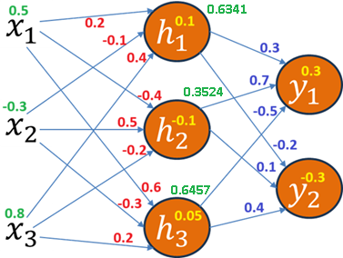

Artificial Neural Network
Example
Input Layer: 3 input neurons ($x_{1}$, $x_{2}$, $x_{3}$)
Hidden Layer: 3 hidden neurons ($h_{1}$, $h_{2}$, $h_{3}$) with sigmoid activation
Output Layer: 2 output neurons ($y_{1}$, $y_{2}$) with softmax activation
Compute Hidden Layer Activations
$$z_{h3}=w_{31}x_{1}+w_{32}x_{2}+w_{33}x_{3}+b_{h3}$$
$$=0.6×0.5+\left(−0.3\right)×\left(−0.3\right)+0.2×0.8+0.05$$
$$=0.6$$
$$h_{3}=σ\left(z_{h3}\right)=\frac{1}{1+e^{−0.6}}≈0.6457$$

Slide 32
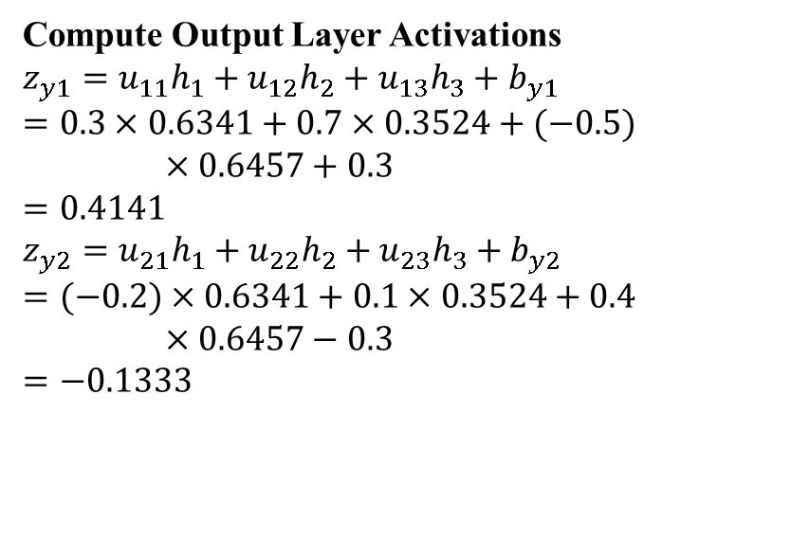
Artificial Neural Network
Example
Input Layer: 3 input neurons ($x_{1}$, $x_{2}$, $x_{3}$)
Hidden Layer: 3 hidden neurons ($h_{1}$, $h_{2}$, $h_{3}$) with sigmoid activation
Output Layer: 2 output neurons ($y_{1}$, $y_{2}$) with softmax activation
Compute Output Layer Activations
$$z_{y1}=u_{11}h_{1}+u_{12}h_{2}+u_{13}h_{3}+b_{y1}$$
$$=0.3×0.6341+0.7×0.3524+(−0.5)×0.6457+0.3$$
$$=0.4141$$
$$z_{y2}=u_{21}h_{1}+u_{22}h_{2}+u_{23}h_{3}+b_{y2}$$
$$=(−0.2)×0.6341+0.1×0.3524+0.4×0.6457−0.3$$
$$=−0.1333$$

Slide 33
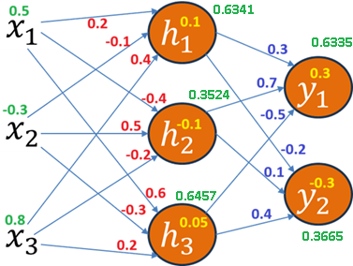
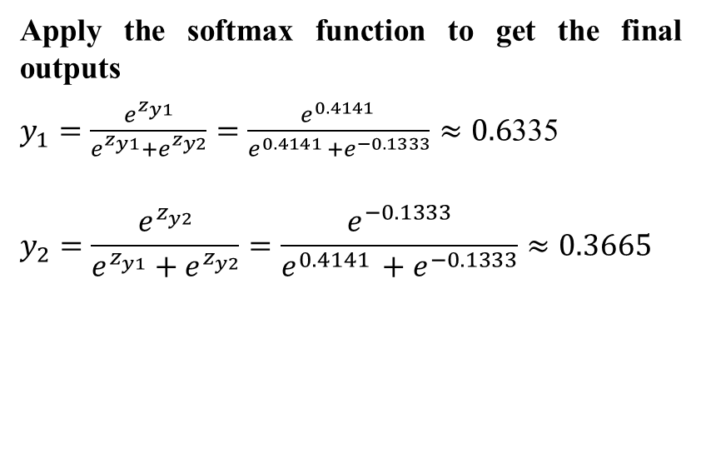
Artificial Neural Network
Example
Input Layer: 3 input neurons ($x_{1}$, $x_{2}$, $x_{3}$)
Hidden Layer: 3 hidden neurons ($h_{1}$, $h_{2}$, $h_{3}$) with sigmoid activation
Output Layer: 2 output neurons ($y_{1}$, $y_{2}$) with softmax activation
Apply the softmax function to get the final outputs
$y_{1}=\frac{e^{z_{y1}}}{e^{z_{y1}}+e^{z_{y2}}}=\frac{e^{0.4141 }}{e^{0.4141 }+e^{−0.1333}}≈0.6$335
$$y_{2}=\frac{e^{z_{y2}}}{e^{z_{y1}}+e^{z_{y2}}}=\frac{e^{−0.1333}}{e^{0.4141 }+e^{−0.1333}}≈0.3665$$

Slide 34
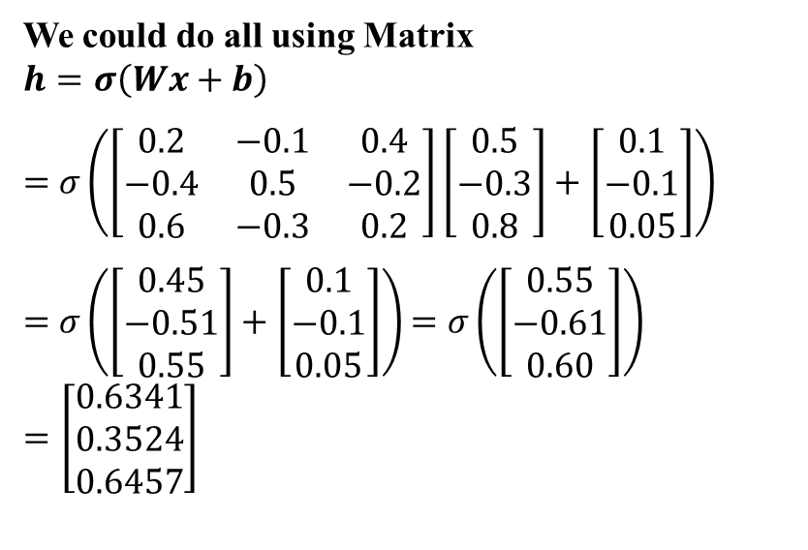
Artificial Neural Network
Example
Input Layer: 3 input neurons ($x_{1}$, $x_{2}$, $x_{3}$)
Hidden Layer: 3 hidden neurons ($h_{1}$, $h_{2}$, $h_{3}$) with sigmoid activation
Output Layer: 2 output neurons ($y_{1}$, $y_{2}$) with softmax activation
We could do all using Matrix
$$h=σ\left(Wx+b\right)$$
$=$ $σ\left(\left[\begin{matrix}0.2 & −0.1 & 0.4 \\ −0.4 & 0.5 & −0.2 \\ 0.6 & −0.3 & 0.2\end{matrix}\right]\left[\begin{matrix}0.5 \\ −0.3 \\ 0.8\end{matrix}\right]+\left[\begin{matrix}0.1 \\ −0.1 \\ 0.05\end{matrix}\right]\right)$
$=$ $σ\left(\left[\begin{matrix}0.45 \\ −0.51 \\ 0.55\end{matrix}\right]+\left[\begin{matrix}0.1 \\ −0.1 \\ 0.05\end{matrix}\right]\right)$ $=σ\left(\left[\begin{matrix}0.55 \\ −0.61 \\ 0.60\end{matrix}\right]\right)$
$$=\left[\begin{matrix}0.6341 \\ 0.3524 \\ 0.6457\end{matrix}\right]$$

Slide 35
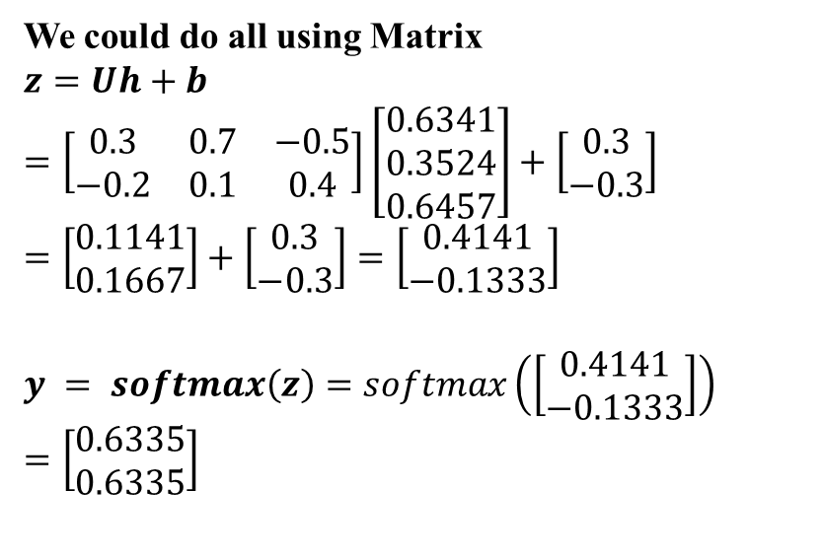
Artificial Neural Network
Example
Input Layer: 3 input neurons ($x_{1}$, $x_{2}$, $x_{3}$)
Hidden Layer: 3 hidden neurons ($h_{1}$, $h_{2}$, $h_{3}$) with sigmoid activation
Output Layer: 2 output neurons ($y_{1}$, $y_{2}$) with softmax activation
We could do all using Matrix
$$z=Uh+b$$
$$=\left[\begin{matrix}0.3 & 0.7 & −0.5 \\ −0.2 & 0.1 & 0.4\end{matrix}\right]\left[\begin{matrix}0.6341 \\ 0.3524 \\ 0.6457\end{matrix}\right]+\left[\begin{matrix}0.3 \\ −0.3\end{matrix}\right]$$
$$=\left[\begin{matrix}0.1141 \\ 0.1667\end{matrix}\right]+\left[\begin{matrix}0.3 \\ −0.3\end{matrix}\right]=\left[\begin{matrix}0.4141 \\ −0.1333\end{matrix}\right]$$
$$y = softmax\left(z\right)=softmax\left(\left[\begin{matrix}0.4141 \\ −0.1333\end{matrix}\right]\right)$$
$$=\left[\begin{matrix}0.6335 \\ 0.6335\end{matrix}\right]$$

Slide 36
Artificial Neural Network
How these all weights (W, U, b) be learned
Back-propagation is an example of supervised learning is used at each layer to minimize the error between the layer’s response and the actual data.
The error at each hidden layer is an average of the evaluated error
Hidden layer networks are trained this way
The goal of back-propagation is to optimize the weights so that the neural network can learn how to correctly map arbitrary inputs to outputs.
The most basic method of training a neural network is trial and error.
If the network isn't behaving the way it should, change the weighting of a the weights.
It takes time, but the trial and error method does produce results.

Slide 37
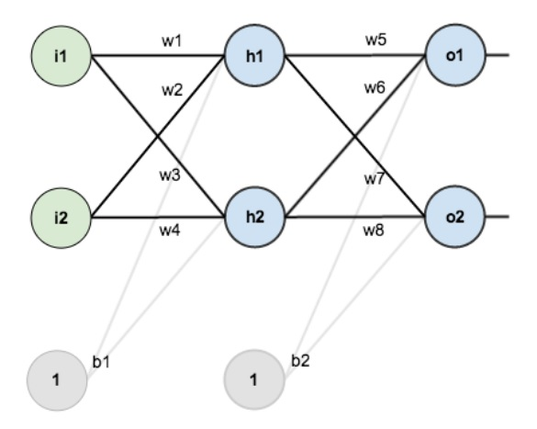
Artificial Neural Network
Learning using Back-Propagation
Sample Neural Network to Calculate Total Error Using Forward Pass Back propagation
The network contains the following:
two inputs
two hidden neurons
two output neurons
two biases
Source: https://mattmazur.com/2015/03/17/a-step-by-step-backpropagation-example/

Slide 38
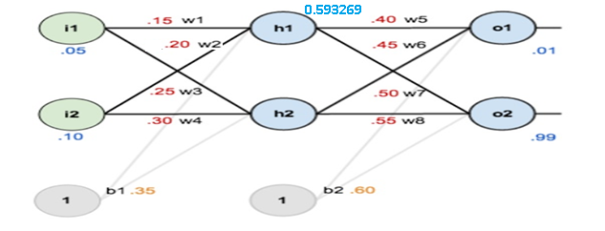
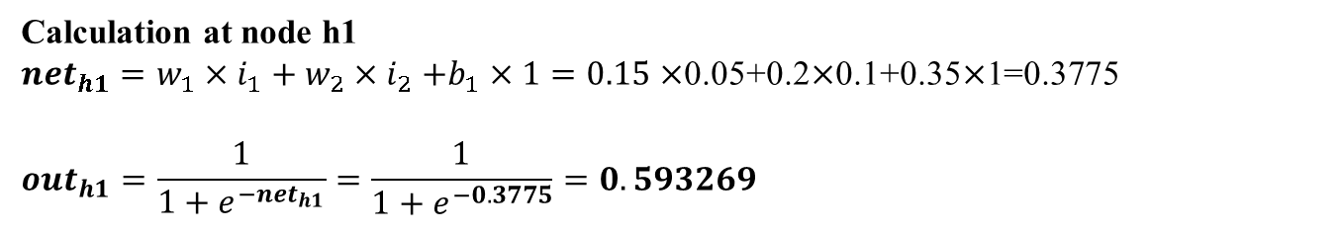
Artificial Neural Network
Learning using Back-Propagation: Error Calculation
0.05, 0.10 → 0.01, 0.99
Calculation at node h1
${net}_{h1}=w_{1}×i_{1}+w_{2}{×i}_{2}+b_{1}×1=0.15×$0.05+0.2$×$0.1+0.35$×$1=0.3775
$${out}_{h1}=\frac{1}{1+e^{−{net}_{h1}}}=\frac{1}{1+e^{−0.3775}}=0.593269$$
Source: https://mattmazur.com/2015/03/17/a-step-by-step-backpropagation-example/

Slide 39
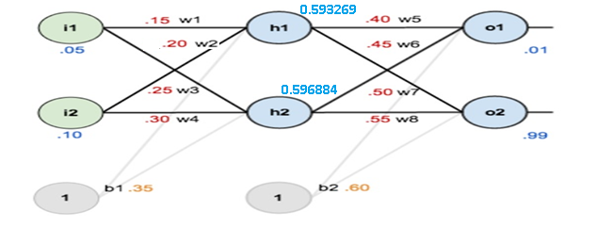
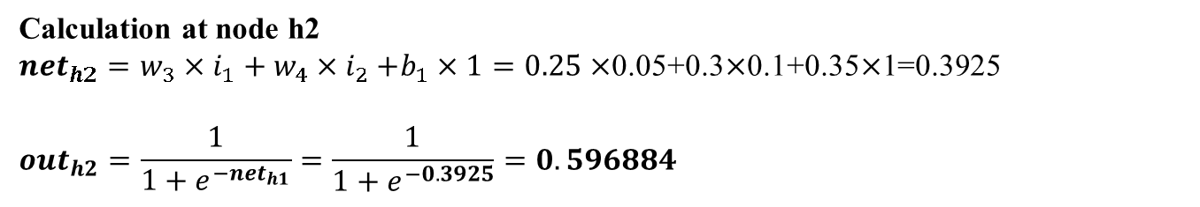
Artificial Neural Network
Learning using Back-Propagation: Error Calculation
0.05, 0.10 → 0.01, 0.99
Calculation at node h2
${net}_{h2}=w_{3}×i_{1}+w_{4}{×i}_{2}+b_{1}×1=0.25×$0.05+0.3$×$0.1+0.35$×$1=0.3925
$${out}_{h2}=\frac{1}{1+e^{−{net}_{h1}}}=\frac{1}{1+e^{−0.3925}}=0.596884$$
Source: https://mattmazur.com/2015/03/17/a-step-by-step-backpropagation-example/

Slide 40
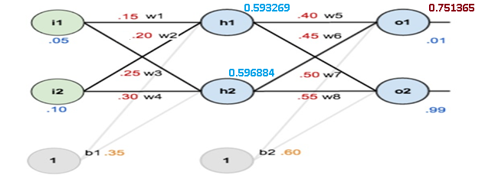
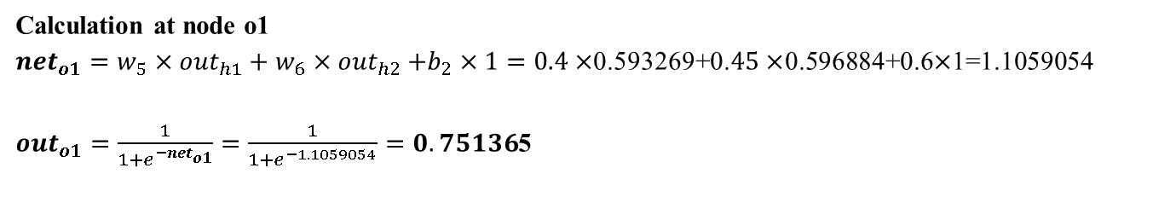
Artificial Neural Network
Learning using Back-Propagation: Error Calculation
0.05, 0.10 → 0.01, 0.99
Calculation at node o1
${net}_{o1}=w_{5}×{out}_{h1}+w_{6}{×out}_{h2}+b_{2}×1=0.4×$0.593269+0.$45×$0.596884+0.6$×$1=1.1059054
${out}_{o1}=\frac{1}{1+e^{−{net}_{o1}}}=\frac{1}{1+e^{−1.1059054}}=0.75136$5
Source: https://mattmazur.com/2015/03/17/a-step-by-step-backpropagation-example/

Slide 41
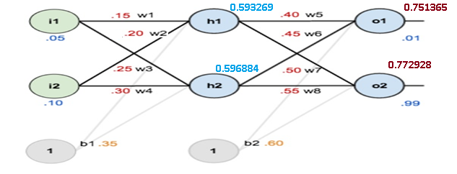
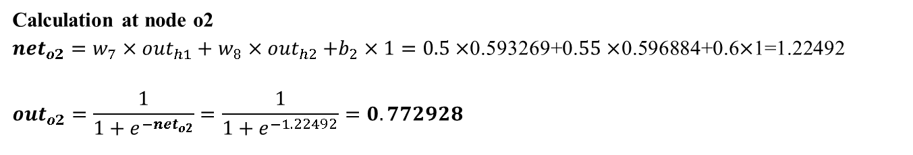
Artificial Neural Network
Learning using Back-Propagation: Error Calculation
0.05, 0.10 → 0.01, 0.99
Calculation at node o2
${net}_{o2}=w_{7}×{out}_{h1}+w_{8}{×out}_{h2}+b_{2}×1=0.5×$0.593269+0.$55×$0.596884+0.6$×$1=1.22492
$${out}_{o2}=\frac{1}{1+e^{−{net}_{o2}}}=\frac{1}{1+e^{−1.22492}}=0.772928$$
Source: https://mattmazur.com/2015/03/17/a-step-by-step-backpropagation-example/

Slide 42
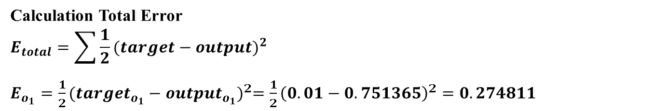
Artificial Neural Network
Learning using Back-Propagation: Error Calculation
0.05, 0.10 → 0.01, 0.99
Calculation Total Error
$$E_{total}=\sum{\frac{1}{2}{(target−output)}^{2}}$$
$E_{o_{1}}=\frac{1}{2}{({target}_{o_{1}}−{output}_{o_{1}})}^{2}=\frac{1}{2}{\left(0.01−0.751365\right)}^{2}=0.274811$
Source: https://mattmazur.com/2015/03/17/a-step-by-step-backpropagation-example/

Slide 43
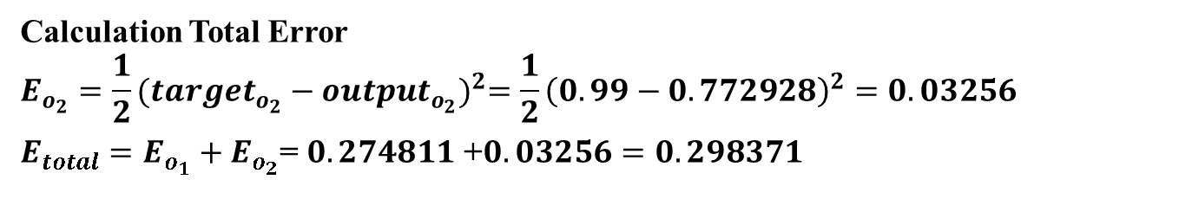
Artificial Neural Network
Learning using Back-Propagation: Error Calculation
0.05, 0.10 → 0.01, 0.99
Calculation Total Error
$$E_{o_{2}}=\frac{1}{2}{({target}_{o_{2}}−{output}_{o_{2}})}^{2}=\frac{1}{2}{\left(0.99−0.772928\right)}^{2}=0.03256$$
$E_{total}=E_{o_{1}}+E_{o_{2}}$= $0.274811$ +$0.03256=0.298371$
Source: https://mattmazur.com/2015/03/17/a-step-by-step-backpropagation-example/

Slide 44
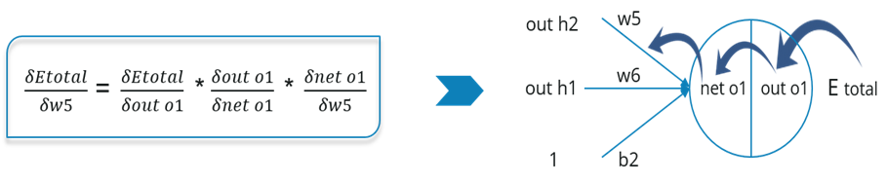
Artificial Neural Network
Propagate the error backward to adjust the weights
0.05, 0.10 → 0.01, 0.99
Now, we will propagate backwards. This way we will try to reduce the error by changing the values of weights and biases.
Consider w5, we will calculate the rate of change of error w.r.t change in weight w5.
Source: https://mattmazur.com/2015/03/17/a-step-by-step-backpropagation-example/

Slide 45


Artificial Neural Network
Propagate the error backward to adjust the weights
0.05, 0.10 → 0.01, 0.99
Since we are propagating backwards, first thing we need to do is, calculate the change in total errors w.r.t the output o1 and o2.
Source: https://mattmazur.com/2015/03/17/a-step-by-step-backpropagation-example/

Slide 46
Artificial Neural Network
Propagate the error backward to adjust the weights
0.05, 0.10 → 0.01, 0.99
Now, we will propagate further backwards and calculate the change in output o1 w.r.t to its total net input.
Source: https://mattmazur.com/2015/03/17/a-step-by-step-backpropagation-example/

Slide 47

Artificial Neural Network
Propagate the error backward to adjust the weights
0.05, 0.10 → 0.01, 0.99
Let’s see now how much does the total net input of o1 changes w.r.t w5?
Source: https://mattmazur.com/2015/03/17/a-step-by-step-backpropagation-example/

Slide 48
Artificial Neural Network
Propagate the error backward to adjust the weights
0.05, 0.10 → 0.01, 0.99
Putting all the values together and calculating the updated weight value
Source: https://mattmazur.com/2015/03/17/a-step-by-step-backpropagation-example/

Slide 49


Artificial Neural Network
Propagate the error backward to adjust the weights
0.05, 0.10 → 0.01, 0.99
Let’s calculate the updated value of w5:
Source: https://mattmazur.com/2015/03/17/a-step-by-step-backpropagation-example/

Slide 50

Artificial Neural Network
Propagate the error backward to adjust the weights
0.05, 0.10 → 0.01, 0.99
Source: https://mattmazur.com/2015/03/17/a-step-by-step-backpropagation-example/

Slide 51
Artificial Neural Network
Propagate the error backward to adjust the weights
0.05, 0.10 → 0.01, 0.99
Similarly, we can calculate the other weight values as well.
After that we will again propagate forward and calculate the output. Again, we will calculate the error.
If the error is minimum we will stop right there, else we will again propagate backwards and update the weight values.
This process will keep on repeating until error becomes minimum.
Source: https://mattmazur.com/2015/03/17/a-step-by-step-backpropagation-example/

